Slide 1
Java Programming
Eclipse Overview and Ant
Module 11
Notes:
1

Slide 2
Agenda
1
Eclipse Overview
2
Create packages using Eclipse
3
Create jar files and Refactoring
Introduction to Apache Ant
Building simple Java Projects

Slide 3
Objectives
At the end of this module, you will be able to:
Outline the eclipse overview.
Create packages using eclipse.
Create jar files and running the project outside of the eclipse.
Identify how to use refactoring in eclipse.
Appreciate the advantages of using ANT
Explore various parts of the build.xml file
Learn about useful targets and useful tasks

Slide 4
Eclipse Overview

Slide 5
What is Eclipse?
Eclipse is as an integrated development environment (IDE) for Java.
Eclipse is created by an Open Source community.
Eclipse is used as a development environment for Java or Android applications.
It is the leading development environment for Java.
Eclipse project is governed by the Eclipse Foundation.

Slide 6
Getting started
Eclipse requires an installed Java Runtime.
Eclipse contains its own development tools, e.g. Java compiler. so it's requires only JRE.

Slide 7
Install Eclipse
Install Eclipse download the package "Eclipse IDE for Java Developers" from the website:
http://www.eclipse.org/downloads
Unpack it to a local directory.
The download is a "zip" file and unzip it.
Use a directory path which does not contain spaces in its name, as Eclipse sometimes has problems with that.
After unpacking the download, Eclipse is ready to be used.
No additional installation procedure is required.

Slide 8
Eclipse Platform
Eclipse is a multi-language software development environment comprising an integrated development environment (IDE) and an extensible plug-in system.
It can be used to develop applications in Java and, by means of various plug-ins, other programming languages.
The Eclipse SDK (which includes the Java development tools) is meant for Java developers.

Slide 9
Platform Components
Name | Description
Ant | Eclipse/Ant integration
Core | Platform runtime and resource management
CVS | Platform CVS Integration
Debug | Generic execution debug framework
Releang | Release Engineering
SWT | Standard Widget Toolkit
Team/Compare | Generic Team and Compare support frameworks
Text | Text editor framework
User Assistance | Help system, initial user experience, cheat sheets etc.
UI | Platform user interface
Update | Dynamic Update/Install/Field Service

Slide 10
Licensing
The Eclipse Public License (EPL) is the fundamental license under which Eclipse projects are released.
Some projects require dual licensing, for which the Eclipse Distribution License (EDL) is available.

Slide 11
Versions
Callisto | 3.2
Europa | 3.3
Ganymede | 3.4
Galileo | 3.5
Helios | 3.6
Indigo | 3.7
Juno | 3.8 and 4.2
Kepler | 4.xx

Slide 12
Create Packages using Eclipse

Slide 13
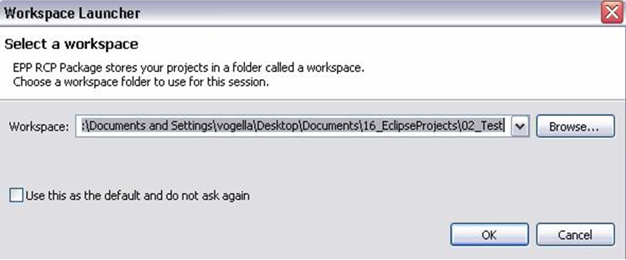
Using Eclipse
To start Eclipse double-click on the file eclipse.exe.
The system will prompt you for a workspace.
Select an empty directory and press Ok

Slide 14
What is the workspace?
Workspace is the physical location (file path) you are working in.
You can choose the workspace during startup of Eclipse or via the menu ( File → Switch Workspace → Others) .
All your projects, source files, images and other artifacts will be stored and saved in your workspace.

Slide 15
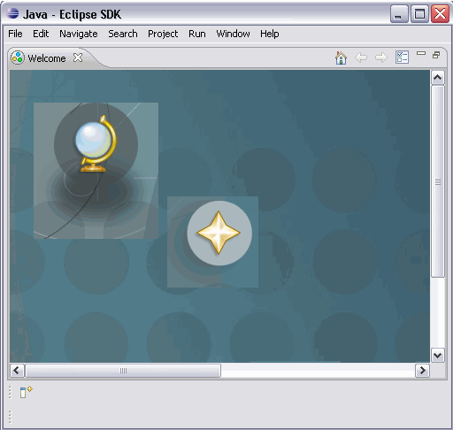
Start Eclipse
Eclipse will start and show the Welcome page.
Close the welcome page by pressing the "X" beside "Welcome"

Slide 16
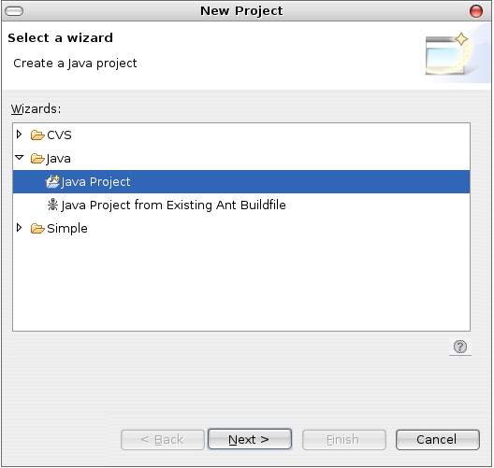
Using Eclipse
Select File->New->Project....from project dialouge box
You should see Java Project appear.
Click on Java Project
Click on Next

Slide 17
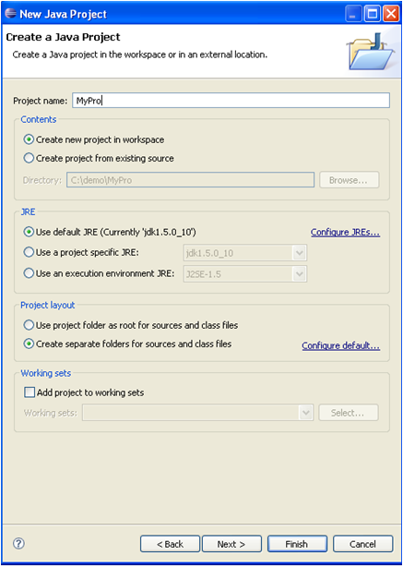
Using Eclipse (Contd.).
Give your project a name
Click Finish

Slide 18
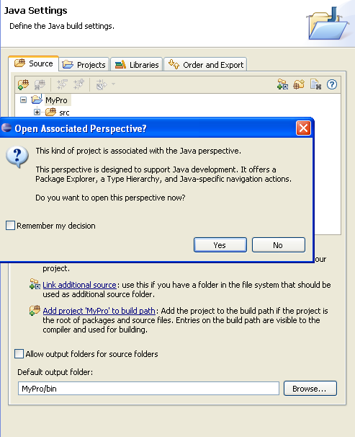
Using Eclipse (Contd.).
If it asks you to switch to the Java Perspective, say yes

Slide 19
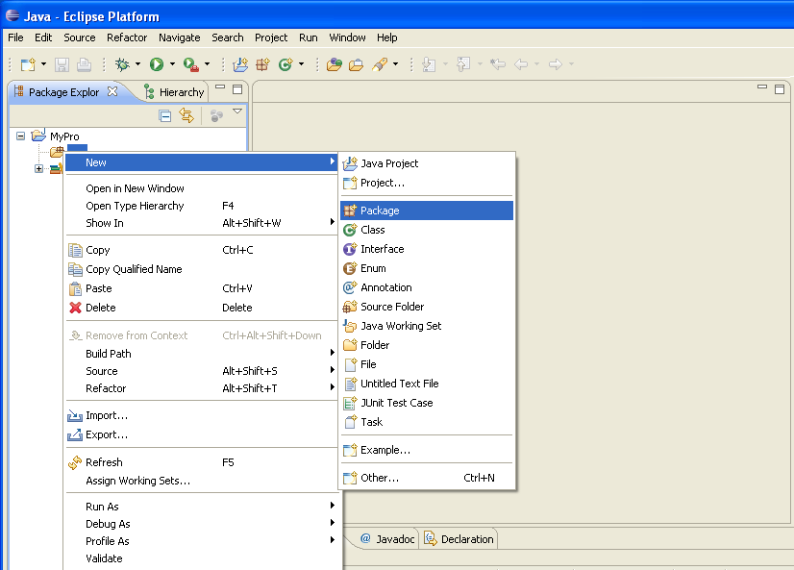
Create package
Select the folder src, right click on it and select New → Package

Slide 20
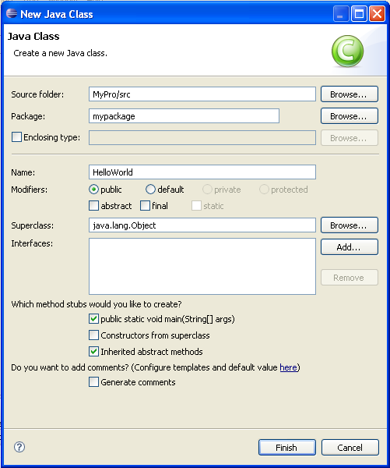
Adding new classes/ files to the project
To add a new class go to the project click File->
New->Class.
The New Class Dialog will appear
Click on the option to create a main() method

Slide 21
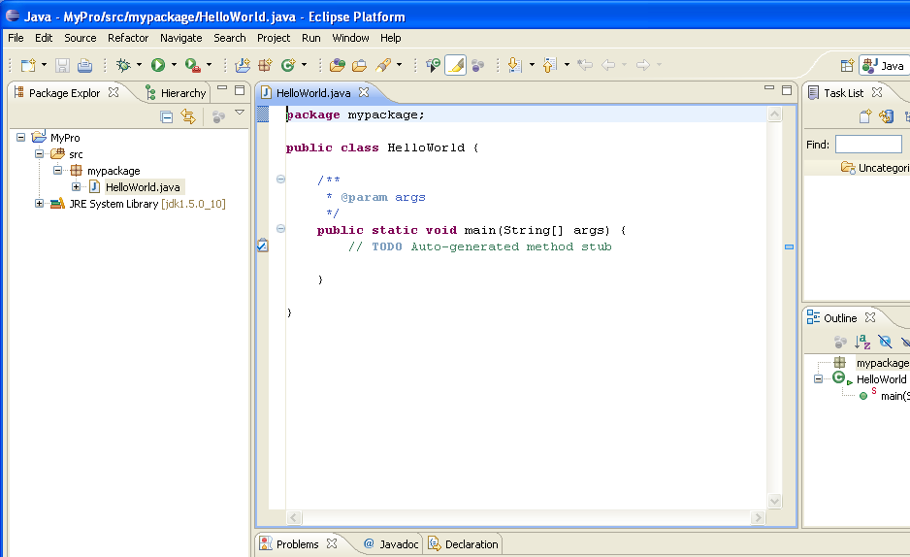
Adding new classes/ files to the project
After adding new class your window should look like this.

Slide 22
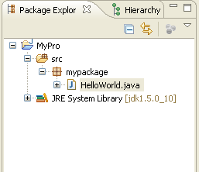
Java Perspective and Package Explorer
By using this we can browse our Java projects.
Select the components you want to work on via double-click.
On the left hand side, this perspective shows the "Package Explorer" View
Notes:
In the middle you have the open Editor for a Java source file.
To the right and below the editor area you find more Views which were considered useful by the developer of the perspective.
For example the "Console" view shows the output of System.out statements in your code.

Slide 23
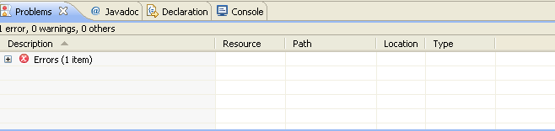
Problems view
To view the problems in your project you can use the "Problems" View which is part of the standard Java Perspective

Slide 24
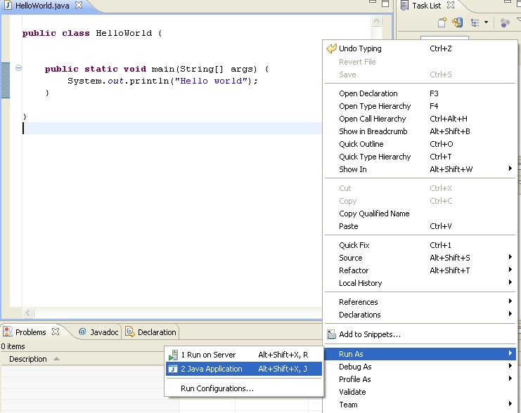
Run your project in Eclipse
Right click on your Java class and select Run-as → Java application

Slide 25
Create jar files and Refactoring

Slide 26
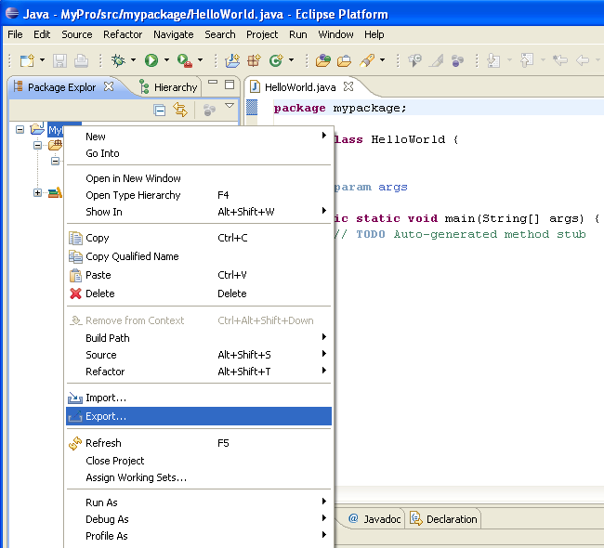
Creating jar files
Right click on your project and select Export

Slide 27
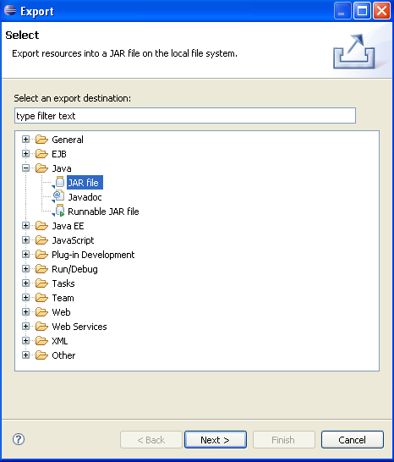
Creating jar files (Contd.).
Select JAR file
Click on next

Slide 28
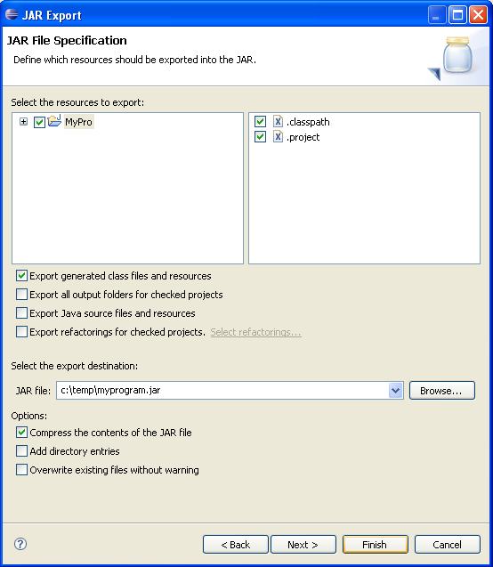
Creating jar files (Contd.).
Select your project
Maintain the export destination and a name for the jar file and give the jar file name as myprogram.jar
Press finish. This creates a jar file in your selected output directory

Slide 29
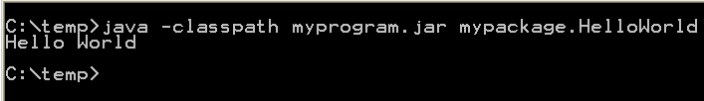
Run your program outside Eclipse
Open a command prompt.
To run this program you need to include the jar file in your classpath.
Switch to your output directory, by typing cd path. For example if your jar is located in c:\temp type cd c:\temp.

Slide 30
Content Assist
Content assistant allows you to get input help in an editor. It can be invoked by pressing CTRL+Space
For example type syso in the editor of a Java source file and then press CTRL+Space. This will replace syso with System.out.println("").
If you have a reference to an object, for example the object obj of the type Student and need to see it's methods, type person. and press CTRL+Space.

Slide 31
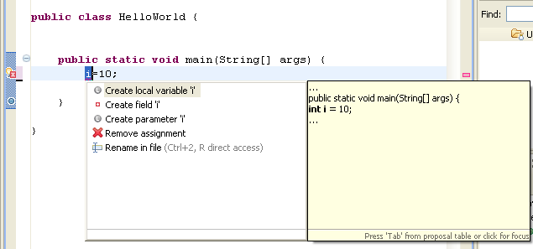
Quick Fix
Whenever Eclipse detects a problem, it will underline the problematic text in the editor. Select the underlined text and press CTRL+1 to see proposals how to solve this problem.
For example type i=10; If i is not yet defined, Eclipse will highlight it as an error
Select the variable and press CTRL+1, Eclipse will suggest creating a field or local variable

Slide 32
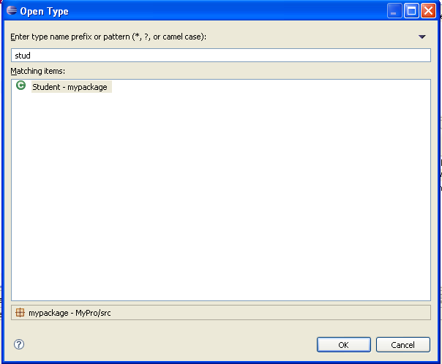
Opening a class
Classes can navigate in your project via the "Package Explorer" View.
Alternatively, you can press CTRL+Shift+T. This will show a dialog in which you can enter the class name to open it.

Slide 33
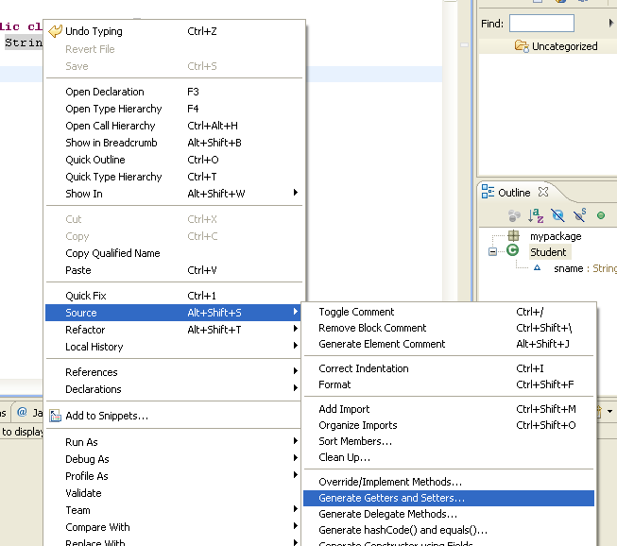
Generating code
Using eclipse we can generate code automatically this will save significant time during development.
For example, if student class contains sname as a property we can generate setters and getters method
Click on Generate setters and getters
Right click on the project via source

Slide 34
Refactoring
Using refactoring we can restructure the code without changing his behavior.
For example renaming a Java class or method is a refactoring activity.
For example you can select your class, right click on it and select Refactor → Rename to rename your class or method.
Eclipse will make sure that all calls in your Workspace to your your class or method will also be renamed.

Slide 35
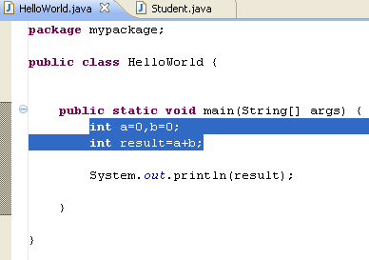
Refactoring (Contd.).
For the next examples change the code of "HelloWorld.java" to the following.
Mark the code and right click and select refactoring -> Extract method

Slide 36
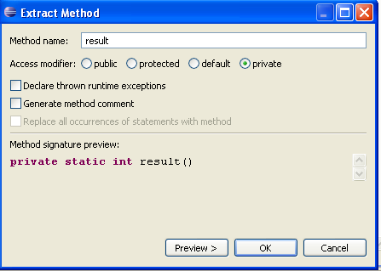
Refactoring (Contd.).
Give method name as result

Slide 37
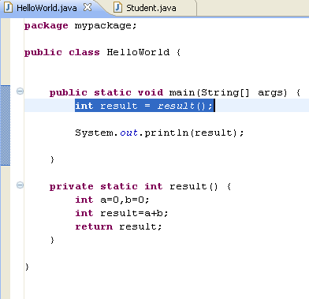
Refactoring (Contd.).
After refactoring class should look like the following

Slide 38
Eclipse Shortcuts
Navigation
Shortcut | Description
CTRL+SHIFT+R | Open / Search for resources, e.g. files
CTRL+SHIFT+T | Open / Search for Types
CTRL+E | Allows to select an editor from the currently open editors
CTRL+F8 | Shortcut for switching perspectives
Ctrl-PageUp/PageDown | Switch to previous /next editor
F3 | Go to declaration of this variable
CTRL+SHIFT+P | Go to the matching bracket

Slide 39
Eclipse Shortcuts (Contd.).
Search
Running programs.
Shortcut | Description
Ctrl+ | Go to the next problem / error
Ctrl- | Go to the previous problem / error
F4 on a variable | Show type hierarchy
CTRL+J,CTRL+K | Incremental search, find next
CTRL+SHIFT+G | Search for references in the workspace
Shortcut | Description
Ctrl+F11 | Run last launched
Alt+Shift+X-J | Run current selected class as java application

Slide 40
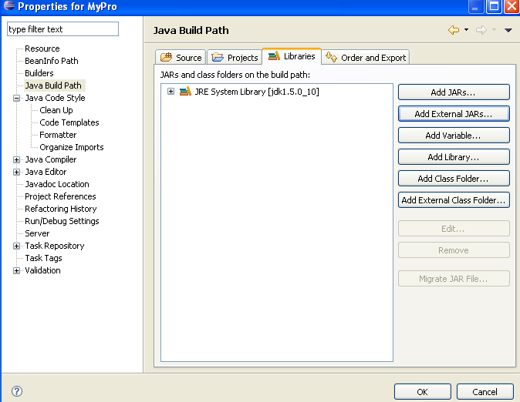
Using jars (libraries)
Using jars (libraries)
Adding a library (.jar ) to your project
Right click on the project select properties->java build path->add external jar files

Slide 41
Add the Javadoc for a jar
Download the Javadoc of the jar and put it somewhere in your filesystem.
Later Javadoc can be added to a jar
Open the Java Build Path page of a project via Right click on a project → Properties → Java Build Path. On the "Libraries" tab expand the library's node, select the "Javadoc location" attribute and press Edit.
Enter the location to the file which contains the Javadoc.

Slide 42
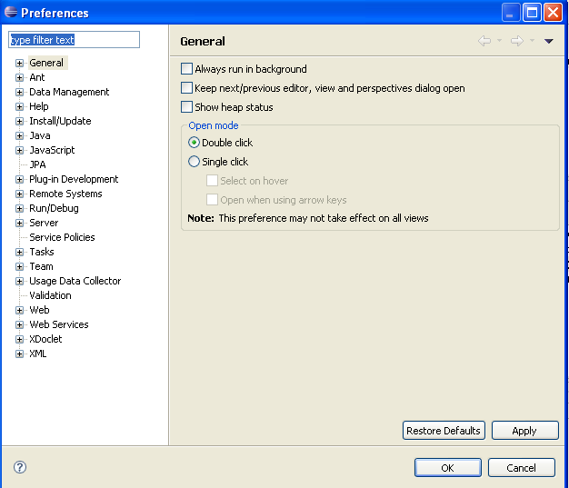
Efficiency Settings
Eclipse Preferences
Eclipse IDE can be controlled via the Preference Settings.
Select Window → Preferences to open the preference settings dialog. You can use the filter box to search for specific settings

Slide 43
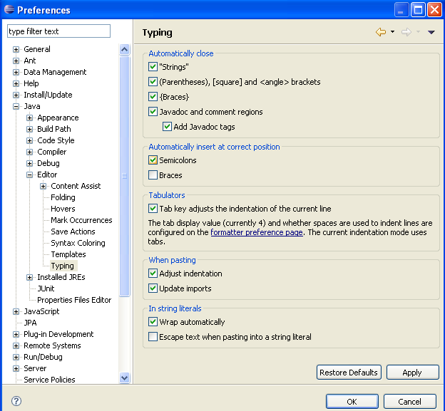
Automatic placement of semicolon
Eclipse can make typing more efficient by placing semicolons at the correct position in your source code.
section "Automatically insert at correct position”, enable the "Semicolons" checkbox
In the Preference setting select Java → Editor → Typing. In the

Slide 44
Quiz
Workspace is the __________you are working in.
Using _________ we can restructure the code without changing his behavior.
_______________is the shortcut key to run current selected class as java application.
___________ is used to navigate classes in our project.
_______________allows you to get input help in an editor. It can be invoked by pressing ___________.

Slide 45
Introduction to Apache Ant

Slide 46
Introduction
Ant stands for ‘Another Neat Tool’
Ant is a free java based build tool from the Apache Jakarta Group
Originally written by James Duncan Davidson who is also the author of Tomcat Server
It’s like a ‘make file’ (a build file in Unix platform) but is better than that as it is cross platform
Uses an XML file to drive its action – build.xml
Extremely powerful and modular
Easily extensible

Slide 47
Why would I want to use Ant?
Provides easy building of a project
Cross platform build files support developers working on different OS
Support unattended builds (e.g. overnight) with mail notification
Can fetch source code from SCM system (CVS, SourceSafe, PVCS…) to enable nightly builds
XML build file is easily built and updated by anyone with basic XML skills
Notes:
Organizing Complex Projects
To see why a build tool is necessary in most, if not all, projects, consider a typical project. You begin by writing your code, in whatever language is appropriate, and then you compile it as you proceed. As the project expands, this becomes a much more difficult job, especially if your code depends on many outside libraries. If this is the case, you may find yourself with large search paths for each compilation.
Compiling Simple Projects
The next logical step is to record the location of the code and any outside libraries and use this information in some kind of script. For example, a Java project may have the following javac command:
javac -classpath ./dist/antBook.jar;%CATALINA_HOME%\common\lib\
mysql-connector-java-3.0.11-stable-bin.jar;
%CATALINA_HOME%\common\lib\servlet-api.jar;
%CATALINA_HOME%\common\lib\jsp-api.jar org\mwrm\plants\client\*.java

Slide 48
Notes:
While this is not as complicated as some compilations, it is complex enough that you run the risk of omitting or misspelling some of the JAR files in the classpath.
Note I am assuming a blank CLASSPATH variable here because that is, in general, good practice, though adding the JAR files to the classpath would solve this problem in this instance. This kind of fix is pretty unwieldy because either you have to specify the CLASSPATH variable every session, which replicates the problems described, or you have to modify the existing variable when you introduce or change a library, which means you have to start a new command-line session to reflect the update.
The simplest solution is to include the javac command in a script, such as a Windows batch file, a Unix shell script, or a Perl script, and run the script from the command line. This allows you to specify the correct libraries at each invocation of the javac command.
Now you have a script that you can use to compile a single class in the project. You can of course generalize the command to compile a whole package at once. If you have more than one package, then you can add more javac commands as needed, as is the case with commands to package the project. This can quickly build up into a large script that you can reuse for each compilation of the project. You can include any command from your operating system in the script, which can make it a powerful tool when working with a project with multiple packages and libraries.
Compiling Larger Projects
The previous situation is no bad place to be if you are working on a small- to medium-sized project by yourself. You have control over the directory structure and the script, and build times are quick because of the project's size. A point will come in most projects, however, where one of these factors makes a script unworkable.
Using a Common Format
You will undoubtedly have written your automation script in the scripting language of your choice, which may not be the language other people working on the project are using. While this may not be a consideration in some projects, it is amazing how often a small project that scratches a personal itch becomes a major project that scratches a lot of itches. Ant, of course, is one such example, as are Perl and any number of open-source projects. Therefore, you should always assume that someone other than you will want to compile your project at some point.
If everyone is using a different technique for automating their section of the project, this makes it difficult to centralize the compiling and packaging process. Ideally, the lead developer runs a single script that performs all the required tasks before a project is ready to distribute to users or clients.
The project leader may even want to distribute the application as part of this process. If this is the case, the script should employ some automated testing to ensure that the project team releases a working application. The script is getting larger and larger as the project increases in complexity.
As you can appreciate, the larger and more serious a project becomes, the larger the need for an automated process becomes. In many stages of the process, human error can lead to delays or unusable code. Testing is absolutely necessary before a project is released to its users. Leaving the testing to a developer when the pressure is on, a deadline is looming, and a product has to ship will inevitably lead to problems. A common format for the script becomes more necessary to integrate all the stages of development.

Slide 49
Notes:
Compiling Only New and Changed Files
Large projects have, by definition, a large number of classes, each of which may have dependencies on a number of outside libraries. As a project grows, the compilation time inevitably grows with it, eventually to the stage where a complex Java application can take up to an hour and an operating system, such as Windows 2000, can take eight hours on the most powerful hardware money can buy.
With this in mind, consider what happens when you change the application in some way, for example, by making a bug fix or adding functionality. The changes are unlikely to warrant a recompilation of the entire project, though this is unavoidable when using a script. It is possible to work around this to a certain extent by breaking the compilation into logical, named chunks within the script and calling only the chunk with the changed code.
Problems will still exist if the chunk itself is large or if a large number of chunks contain changed code. This also assumes the person building the project knows which pieces of the application have changed, which is again a problem in a large application written by a number of people where the number of changes could be large.
Controlling the Project
On a small project, you have control of the script and the structure of the project, so you have a good overview of where everything is in the directory hierarchy. This allows you to change the directory structure to suit your development style and the type of scripting you are using.
On larger projects, you will not necessarily have this control, so keeping the script up-to-date and usable becomes increasingly difficult. Large scripts used by many people can easily degenerate into a mess of unmaintainable gibberish.
Reflecting on the Project's Life Cycle
Obtain the source code from the archive or repository.

Slide 50
Notes:
Create a directory structure to hold the source code and the resultant binaries. This typically includes a temporary or scratch directory where you carry out the intermediate stages. You may also want to move any outside libraries into this directory structure for ease of access.
Configure the script to suit your environment. This is necessary here because someone else has written the source code. Their directory hierarchy may not be the same as yours.
For instance, third-party libraries could be in different places on each system (usr/local/java/tomcat5/common/lib/servlet-api.jar versus usr/local/java/jakarta-tomcat-5.5.9/common/lib/servlet-api.jar, for example). In fact, someone else might not have been working on the same operating system. You should make sure any paths are correct and that the script references any outside resources properly.
As described, this may be more difficult if the script is in a format with which you are not familiar. You may even find that the script will not run on your operating system because it was written in an incompatible scripting language, so you will have to convert it to one your operating system understands.
Compile the source code with your configured script.
Package the binary files into libraries for the users. You can distribute the example application as a JAR file for command-line access or a WAR file for use on a servlet container.
In this step, you may be adding image and configuration files to the distribution. If your application requires outside libraries to run, you may also be adding them to the package.
The web application version of the example application can include the third-party libraries mentioned previously so that it is a discrete package. Alternatively, you can let the administrator of the servlet container place the third-party libraries in an appropriate location.
Unit test the application with appropriate criteria. Ideally, you would use a testing framework with predefined test cases. If you are responsible for the code and the project is still at a development stage, then performance testing may be appropriate once unit testing has finished. You should test the application on a test server and not a production server.
Create the documentation bundle. This should include README files and instructions on how to install and use the application. The documentation could be simple text files or could be sophisticated HTML pages that you have generated using a standard process such as the javadoc utility. If you are distributing the documentation as a web application, which is an option with the example application, you should create a WAR file. Another option is an archive that the user can expand in their file system.
Package the entire distribution, which includes the packaged binaries and the documentation bundle. At this stage, you have to consider who you will be sending the application to and tailor the package accordingly. This may mean you have to produce more than one package. For example, Windows users prefer a *.zip file, and Unix users prefer a *.tar.gz or *.bz2 archive.
Provide the application to your users. You can achieve this in a number of ways, including using e-mail, using FTP, copying and pasting onto a web server, or hot deploying onto a running web server.
Clean up the directory structure. When you have finished with the scrap directory and the third-party libraries, you may want to remove them from your file system. The scratch directory created in step 2 may no longer be necessary, and you could remove it if this is the case. Should you want to do a clean build every time, you will definitely want to do this.
This is quite a list of actions to perform before an application is ready for your users.
The serial nature of the previous list belies some of the complicated dependencies and relationships within a build process. For example, you cannot package the application unless you have compiled the code and successfully built the documentation bundle.

Slide 51
Installing Ant
Download Ant binary distribution from:
http://ant.apache.org/bindownload.cgi
Set ANT_HOME to where you installed Ant
Include $ANT_HOME\bin in PATH
Make sure JAVA_HOME is set to point to JDK
Notes:
set ANT_HOME=<path to ant installation directory> e.g c:\ant
set JAVA_HOME=<path to JDK installation> eg c:\jdk1.5
set PATH=%PATH%;%ANT_HOME%\bin

Slide 52
Running Ant from the command line
The ant command syntax is as shown below
ant [options] [target [target2 [target3] ...]
Some important options are :
-help, -h | Displays the help message.
-version | Prints version information.
-verbose, -v | Prints all possible output that Ant produces.
-lib <path> | Specifies a path to search for JARs and classes, in addition to your classpath
-buildfile <file> -file <file> -f <file> | Specifies the build file to use for this build. The value of <file> can be an absolute path or a path relative to the current directory. The default is a file called build.xml in the current directory.
-D<property>=<value> | Sets the value of property <property> to <value>
-keep-going, -k | Forces Ant to execute every target that does not depend on a failed target. This ensures that at least part of the build was successful.
-propertyfile <name> | Loads all the properties from specified property file

Slide 53
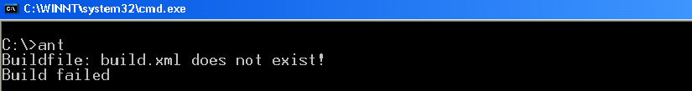
Running Ant from the command line
The list of targets tells Ant which targets to execute in the build file
Type ant command from the command prompt
The error message is because ant command looks for a build.xml file in the current directory, and we have not created one
Let’s learn about the build.xml and it’s various parts in the coming slides
Output

Slide 54
A Sample build.xml file
<project name="My Project" default="jar" basedir=".">
<property name="dir.src" value="src"/>
<property name="dir.build" value="build"/>
<property name="dir.dest" value="dest"/>
<target name="clean" description="Removing the all generated files.">
<delete dir="${dir.build}"/>
<delete dir="${dir.dest}"/>
</target>
<target name="prepare" depends="clean">
<mkdir dir="${dir.build}"/>
<mkdir dir="${dir.dest}"/>
<mkdir dir="${dir.src}"/>
</target>
<target name="compile" depends="prepare" description="Compilation of all source code.">
<javac srcdir="${dir.src}" destdir="${dir.build}"/>
</target>
<target name="jar" depends="compile" description="Generates javasession.jar file in to the 'dest' directory.">
<jar jarfile="${dir.dest}/javasession.jar" basedir="${dir.build}"/>
</target>
</project>
Notes:
Each XML document must be well formed, meaning it must have a root element that contains all other elements and each element must be closed by a closing element or must be a stand-alone, self-closing element. The root element of every Ant build file is the <project> element.
Minimum requirements of a build.xml file
<?xml version="1.0"?>
<project>
</project>

Slide 55
Structure of the Build file
Top level XML tag is “project”; there should be only one project tag in the build file
<project name="My Project" default="jar" basedir=".">
This specifies that
  The default target for the project named “My Project” is “jar”
  All activity is relative to the directory in which the build file lives
    basedir can be set to different directory but most likely will be set to “.”
    If no basedir is specified, it defaults to “.”
Notes:
The project tag is used to create our project and its attributes are used to handle further processing of the project. The name attribute is used to specify the project name and the default attribute is used to specify which target will be called as default when the program will run and the basedir attribute is used to calculate the absolute path of the parent directory.
<project name="My Project" default="jar" basedir=".">
If you call ant with no argument it’ll execute the target called ‘jar’.

Slide 56
<target>
A project is made up of a number of targets that tell Ant what it should do
Targets consists of a series of tasks that are specific actions for ant to take
Have these attribute
  name (required)
  depends (comma separated list of other targets)
  if
  unless
  description
Notes:
A target is a collection of Ant tasks that you want to run as a unit.
The <target> element is the XML representation of a target in the build file. As already mentioned, it is a child element of <project>. It also can contain as many task elements as are required. When Ant calls a target, each of these tasks runs in turn until they all complete or one fails.
In the target tag, name attribute is used for target name and the depends attribute is used to give sequence of target, i.e., which target will execute first, one target may depend on one or more other targets.
The if attribute is used in case of condition, whether property exists or not; the target will be executed if the property is found. The unless attribute is used as like else condition whether property does not exist, the target will not be executed and the description attribute is used for only giving details about target.

Slide 57
<target> (Contd.).
All targets must have a name such as “compile”,”init”, “clean”
Can have a “description” to explain the target’s purpose
Targets can depend on each other
  A target that depends on another target will demand that the other target gets executed first
  <target name=“jar” depends=“compile”> ………</target>
  Multiple targets can be specified in depends; they will be executed in the order listed
  <target name=“jar” depends=“prepare,compile”>
  </target>
Notes:
<target name="A"/>
<target name="B" depends="A"/>
<target name="C" depends="B"/>
<target name="D" depends="C,B,A"/>
Here if we want to execute target D, it first executes target A, then target B, then target C and finally target D gets executed because of the dependency specified.

Slide 58
Review Questions
1. ANT is --------
a. Another Nice Tool
b. A New Tool
c. Another Neat Tool
d. None of the above
2. The build file used by ANT command is --------
a. Makefile
b. web.xml
c. ant.xml
d. build.xml

Slide 59
Building simple Java Projects

Slide 60
Target - init
The first target you will probably specify is “init”
  Used to set up properties that you will use throughout your build file
  Properties can be set directly or by specifying a properties file
  The advantage of setting variable here is, it gives you one place to make changes that ripple through the entire file
  Using a properties file is even better because the syntax is simpler
  <target name=“init” >
  <property file=“build.properties” />
  </target>

Slide 61
Target - prepare
The second target should be “prepare”, and it should depend on “init”
Create any directory structure you need here
Perhaps copy some needed files
  <target name=“prepare” depends=“init”>
    <mkdir dir=“${build.dir}”/>
    <mkdir dir=“${build.dir}\META-INF”/>
  <target>
Notice the ${build.jar} syntax; this is dereferencing a property that was set in the “init” target

Slide 62
Tatget - clean
“clean” is useful for enabling clean builds
Generally just deletes stuff from previous runs to ensure that no artifacts persist between builds
  <target name=“clean” depends=“init”>
    <delete dir=“${build.dir}”/>
  </target>
For clean build, you should execute the “clean” target before trying to build anything

Slide 63
Target - compile
Compile some/ all of your source files in this target
  <target name=“compile” depends=“prepare”>
    <echo message=“Compiling now…”/>
    <javac srcdir=“${src.dir}” destdir=“${build.dir}” includes=“**/*.java” />
  </target>
“**/*.java” notation means “all files recursively” from ‘srcdir’ that ends with .java

Slide 64
Target - jar
Once you’ve compiled everything, we should create the jar file
  <target name=“jar” depends=“compile”>
    <jar destfile=“${dist.dir}/${name}.jar” basedir=“${build.dir}”/>
  </target>
This builds a jar file
  The name of the jar file as pointed by property ${name}
  The Jar file will be created In the directory as pointed to by ${dist.dir}
  Including everything from the ${build.dir} directory

Slide 65
Built-In Tasks
We will now look at some of the many built-in tasks that ship with Ant
We will show some of the most common options; the others are left as exercise…
Ant comes with extensive documentation on these tasks showing all possible options
We will begin with “property”, “javac” and “jar” and go into the others in alphabetical order

Slide 66
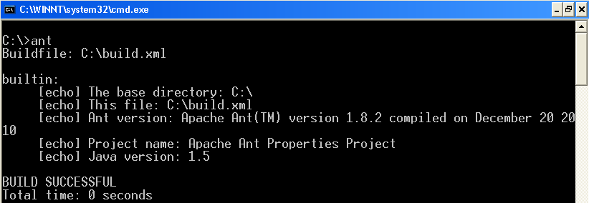
Working with Properties
Hard-coding directory paths and filenames is not a good idea in any area of programming
Properties comes handy in this case
The ${} notation is used by Ant to retrieve the value of the Property
Displaying default properties of Ant
<project name="Ant Properties Project" basedir="." default="builtin">
<target name="builtin">
<echo message="The base directory: ${basedir}"/>
<echo message="This file: ${ant.file}"/>
<echo message="Ant version: ${ant.version}"/>
<echo message="Project name: ${ant.project.name}"/>
<echo message="Java version: ${ant.java.version}"/>
</target>
</project>
Output
Notes:
While you write an Ant build file in XML, Ant has a few tricks up its sleeve to make the build file as flexible as possible. This is particularly important when working with platform-independent build files. Hard-coding directory paths and filenames is not a good idea in any area of programming, and you should attempt to avoid it in your source code. If this is the case, you don't want to undo all your careful work by hard-coding values into your build files.
Properties Description
ant.file - The absolute path to the current build file.
ant.java.version - The version of Java that Ant uses.
ant.project.name - The name of the project as set in the <project> element's name attribute.
ant.version - The version of this Ant installation. This is not just the version number and includes information such as the compilation date.
basedir - The base directory for this build, as defined in the basedir attribute of the <project> element. If you do not set this attribute, Ant uses the current directory.

Slide 67
Setting properties in a build.xml
The <property> element is defined as a task, unlike the <project> and <target> elements
The<property> elements can be included inside a target depending on which target has been selected
Properties can also be set at the beginning of a build file so that they apply to the entire build
Properties inside a target overrides any properties set at the project
  <target name="properties.custom">
  <property name="version" value="1.1"/>
  <echo message="Version. = ${version}"/>
  </target>

Slide 68
Properties file
All the property values used in a build.xml can be grouped in a separate ‘properties’ file
The property values are immutable
If you set a property value in the properties file you cannot change it in the build file
Sample.properties
web.lib.dir=${web.dir}/WEB-INF/lib
build.classes.dir=build/classes
Using that in build.xml
<property file=“Sample.properties" />
Notes:
Example:
<?xml version="1.0" ?>
<project name="AntExample3" default="war">
<property file="Sample.properties" />
<target name="init" depends="clean">
<mkdir dir="${build.classes.dir}"/>
</target>
</project>

Slide 69
<javac>
The javac task compiles java source into class files, just as the javac command-line tool does
If you store your source code in directory structures that match the package structure of your application, then Ant will recompile only those files that have changed (very useful)
It’s possible to use different compilers
For eg:
  classic - the standard compiler of JDK 1.1/1.2
  modern - the standard compiler of JDK 1.3/1.4/1.5/1.6/1.7/1.8)
  gcj - the gcj compiler from gcc
This can be specified by either setting the global build.compiler property or the compiler attribute of the javac task
Notes:
compiler attribute of <javac>
If this attribute is not set, the value of the build.compiler property, if set, will be used. Otherwise, the default compiler for the current VM will be used.

Slide 70
<javac> (Contd.).
  <javac srcdir=“${src.dir}” destdir=“${build.dir}”
    Optimize=“off” debug=“on” deprecation=“on”
    Classpath=“${classpath}” includes=“**/*.java” excludes=“**/*Test*” />
This task will
  Compile all java source files,except those with “Test” in their name names in the ${src.dir} directory and below
  Place the compiled classes in the ${build.dir}
  Include debug information in classes
  Not do any static optimization
  Shows deprecation warnings

Slide 71
<javac> (Contd.).
The “srcdir” attribute is optional if there are nested “src” tags
  <javac ..>
    <src path=“${src.dir}”/>
    <src path=“${other.src.dir}”/>
    <exclude name=“foo/bar/baz/**/*.java” />
  </javac>
The task above will
  Compile source files in the directory specified by both the ${src.dir} and ${other.src.dir} properties and their children
  Exclude files in the foo.bar.baz package and any sub package

Slide 72
<javac> (Contd.).
“classpath” is an optional parameter, but you probably won’t get far without it
If “destdir” is omitted, the files are compiled into the same directory as the source
“debug”,”optimize” and “deprecation” are all “off” by default
About the least you can get away with is this”
  <javac srcdir=“${src.dir}”/>

Slide 73
<jar>
Creates a jar file
<jar destfile=“${dist.dir}/${name}.jar” basedir=“${build.dir}” />
The basedir attribute is the reference directory from where to jar
This includes everything under ${build.dir} in the jar file based on the “name” property, located in the directory specified by the “dist.dir” property
Includes a MANIFEST.MF directory

Slide 74
<jar> (Contd.).
Also supports includes and excludes
  <jar basedir=“${build.dir}” destfile=“${dist.dir}/${name}.jar”
  includes=“**/*.class” excludes=“**/*Test*.class” />
You can also nest <fileset> tags inside it to specify includes and excludes
Supports a nested <metainf> tag to specify what should be included in the META-INF directory (you can specify multiple <metainf> tags to pull files from different directories)
  <jar …>
    <meatainf dir=“${etc.dir}” includes=“**/*.xml” />
  </jar>

Slide 75
<ant>
Calls ant from within ant on a different buildfile
Useful for building subprojects (e.g. partitioning large projects)
  <ant dir=“./test” antfile=“build.xml” target=“compile”
  ouput=“test.log” >
  <property name=“param1” value=“1.0” />
  </ant>
If “antfile” is omitted, “build.xml” is assumed
If “target” is omitted, the default target is used
If “output” is omitted, output goes to the console
Properties from the parent are visible in the child and override those in the child (unless specified)

Slide 76
<antcall>
Calls another target within the same buildfile
Can pass parameters to it
Useful for reusing targets
  <target name=“foo”>
  <echo message=“param1=“${param1}” />
  </target>
  <target name=“bar”>
  <antcall target=“foo”>
  <param name=“param1” value=“baz” />
  </antcall>
  </target>

Slide 77
<available>
Sets a property if a specified resource is available on the current system
This resource can be a file, a directory, a class in the classpath, or a JVM system resource.
Useful for targets that can’t/ shouldn’t be executed under certain circumstances
  <!– sets the “has.junit” peroperty to “true” if the TestCase class is found in the classpath →
  <available property=“has.junit” classname=“junit.framework.TestCase” >
  <classpath refid=“classpath” />
  </available

Slide 78
<available> (Contd.).
Looks for the file called “foo.txt” and sets the “file.there” property if found
  <available property=“file.there” file=“./foo.txt” />
Looks for the “foo.properties” resource in the classpath and sets the property if found
  <available properties=“foo.there” resource=“foo.properties” >
  <classpath refid=“classpath” />
  </available>

Slide 79
<condition>
Sets a property if a given series of requirements are met
Several nested conditions are available
  and, or, not, os, available, uptodate, equals,istrue, isfalse,…
Sets the property javamail.complete if both the JavaBeans Activation Framework and JavaMail are available in the classpath.
  <condition property="javamail.complete">
  <and>
  <available classname="javax.activation.DataHandler"/>
  <available classname="javax.mail.Transport"/>
  </and>
  </condition>

Slide 80
<copy>
Copy a directory, excluding some files
  <copy todir=“../test”>
  <fileset dir =“${src.dir}” excludes=“**/*Test*.java” />
  </copy>
Copy a directory, renaming the files !
  <copy todir=“../test” >
  <fileset dir=“${src.dir}” />
  <mapper type=“glob” from=“*” to=“*.bak” />
  </copy>

Slide 81
<ear>
Builds an enterprise archive
Specialized version of <jar>
Easily add eib-jars, wars etc
Supports “manifest” attribute; use this if you need to specify a classpath
  <ear destfile=“${deploy.jsr}” appxml=“${etc.dir}/application.xml”>
  <fileset dir=“${build.dir} “ includes=“*.war,*.jar” />
  </ear>
Notes:
destfile - the EAR file to create
appxml - The deployment descriptor to use

Slide 82
<echo>
Prints a message to the console or a file
Can expand properties just like other tasks
If the “file” parameter is omitted, the console is used
The “append” parameter works with the “file” parameter when an output file exists
Works like the “echo” command (UNIX/DOS)
Send a static message to the console
  <echo message=“now compiling..” />
  <echo> This is another way to do it </echo>
Append a dynamic message to a file
  <echo message=“myvar=${myvar}” file=“log.txt” append=“yes” />

Slide 83
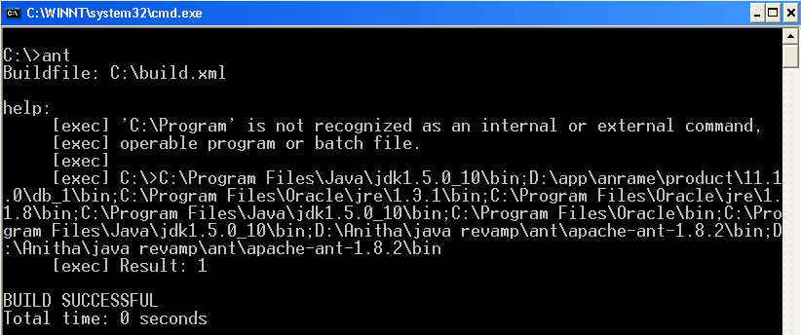
<exec>
Executes a system command
Command line arguments should be specified as nested <arg> elements
The <exec> task delegates to Runtime.exec
One normally needs to execute the command shell executable cmd using the /c switch
<target name="help">
<exec executable="cmd">
<arg value="/c"/>
<arg value="a.bat"/>
</exec>
</target>
%PATH%
a.bat
Output
Notes:
The <exec> task delegates to Runtime.exec. One normally needs to execute the command shell executable cmd using the /c switch

Slide 84
<javadoc>
Generates javaDoc from your source files
Much easier than running javadoc at the command line
You really need to structure your source according to your package structure for best results
Here’s the simple case, generating the docs for the packages listed, in ${src.dir}, placing the generated files in ${doc.dir}
  <javadoc sourcepath=“${src.dir}” destdir=“${doc.dir}”
  packagenames=“foo.*,bar.*,baz.*” />

Slide 85
<javadoc> (Contd.).
Some of the useful parameters are
  sourcepath – where the sources to process live
  destdir – where to dump the generated HTML files
  author –includes the @author info
  version – includes the @version infor
  use – generates pages showing method/class usage from the source
  windowtitle – a string of HTML to include as the <title > element in the generated files
  access –which level of access should be included (e.g publid, private); protected is default
  packagenames – those packages to include in the doc
  excludepackagenames –packages not to include

Slide 86
<mail>
Used to send email to the email address specified
Useful for overnight builds
The log of what happened can be sent to you in the morning
Also useful if a job break to notify someone immediately
  <mail from=“anitha.ramesh@wipro.com” tolist=“you@yourbox.com” subject=“Nighty build results” files=“log.txt” />
The contents of log.txt will go in the body of the message

Slide 87
<mail> (Contd.).
Could also send email based on a message string
  <mail from=“anitha.ramesh@wipro.com” tolist=“you@yourbox.com” subject=“Nighty build results” message=“Finished building ${name}” />
‘tolist’ can be list of email addresses separated by commas
Notes:
‘files’ can be a comma separated list of files to send
Supports nested file sets to select files to send as attachments

Slide 88
<mkdir>
Create a directory
  <mkdir dir=“${build.dir}/temp” />
Create an entire directory structure !
  <mkdir dir=“${build.dir}/foo/bar/baz” />

Slide 89
<move>
Like copy, only it moves things
Like the Unix “mv” program, can be used to rename things
  <move file=“foo.java” tofile=“foo.save” />
Or just move a file
  <move todir=“${java.dir}”>
  <fileset dir=“${src.dir} includes=“**/foo*.java” />
  </move>

Slide 90
<parallel>
Runs two or more Ant tasks (not targets) simultaneously in separate threads
Useful if you have extra horsepower on a box or have several tasks that are independent yet last a while
Caution must be exercised to not parallelize tasks that might crash (eg. Two javac tasks)
Supports nested <sequential> to un-parallelize for some nested tasks ..
  <parallel>
  <copy todir=“${remove.drive.one}” …/>
  <copy todir=“${remove.drive.two}” …/>
  </parallel>

Slide 91
<tstamp>
By default, sets the DSTAMP, TSTAMP and TODAY properties in the build file
Specifying the ‘property’ parameter will place the date/time string in that property
The ‘pattern’ parameter is a string format, in the format used by java.text.simpleDateFormat
These properties can be referenced later in the file
Set DSTAMP, TSTAMP and TODAY
  <tstamp/>
Specifies a property name and a format
  <tstamp>
  <format property=“TODAY_US”
  pattern=“ dd-MMMM-YYYY” />
  </tstamp>
Notes:
Sets the DSTAMP, TSTAMP, and TODAY properties in the current project. By default, the DSTAMP property is in the format "yyyyMMdd", TSTAMP is in the format "hhmm", and TODAY is in the format "MMMM dd yyyy". Use the nested <format> element to specify a different format .

Slide 92
<tstamp> (Contd.).
Specify the jar file name using one of the default <tstamp> properties
  <tstamp/>
  <property name=“jave.name” value=“${name}-${DSTAMP}.jar” />
Specify the jar file name using a custom property
  <tstamp>
  <format property=“TODAY_US” pattern=“d-MMMM-yyyy” />
  </tstamp>
  <property name=“jar.name” value=“${name}-${TODAY_US}.jar” />

Slide 93
<war>
Specialized version of the <jar> task for creating web archives
To create the war file you need to specify
  the web directory
  lib directory and
  the classes directory
destfile attribute - specifies the war file location
webxml attribute - specifies the web.xml file location
  <target name="war" depends="compile">
  <war destfile="dist/AntExample.war" webxml="WebContent/WEB-INF/web.xml">
  <lib dir="WebContent/WEB-INF/lib"/>
  <classes dir="build/classes"/>
  </war>
  </target>
Notes:
Destfilethe-WAR file to create.
Webxml-The servlet configuration descriptor to use.
The nested lib element specifies a FileSet. All files included in this fileset will end up in the WEB-INF/lib directory of the war file.
The nested classes element specifies a FileSet. All files included in this fileset will end up in the build/classes directory of the war file

Slide 94
Review Questions
1. Which of the following is a mandatory parameter for javac task?
a. classpath
b. srcdir
c. destdir
d. debug
2. ant is a --------
a. target
b. task
c. build file

Slide 95
Summary
In this module, we were able to:
Outline the eclipse overview
Create packages using eclipse
Create jar files and running the project outside of the eclipse
Identify how to use refactoring in eclipse
Appreciate the advantages of using ANT
Explore various parts of the build.xml file
Learn about useful targets and useful tasks

Slide 96
References
Lars Vogel (2012). Eclipse IDE Tutorial. Retrieved on April 28, 2012, from, http://www.Vogella.com/articles/Eclipse/article.html
Rajani Ramsagar and TecNoesis (2009). Eclipse IDE Primer. Retrieved on April 28, 2012, from, http://tecnoesis.wordpress.com/category/eclipse-ide-tools-ides-2/eclipse-ide-introduction/

Slide 97
Thank You

